Slide 1
4. Variables
- Shivam Malhotra
Notes:
We designed this template so that each member of the project team has a set of slides with its own theme where he/she can present their research. Members, here’s how you add a new slide to just your set:
Mark where you want to add the slide: Select an existing one in the Thumbnails pane, click the New Slide button, then choose a layout.
The new slide gets the same theme as the previous one you selected.
Careful! Don’t annoy your fellow presenters by accidentally changing their themes. That can happen if you choose a theme Variant from the Design tab, which changes all of the slides in your presentation to that look.

Slide 2
Find output
#include <iostream.h>
int main()
{
cout << "When we divide 7 by 3\n";
cout << "Quotient = " << 7/3;
cout << "\nRemainder = " << 7%3;
return 0;
}

Slide 3
Find output
#include <iostream.h>
int main()
{
cout << "When we divide 7 by 3\n";
cout << "Quotient = " << 7/3;
cout << "\nRemainder = " << 7%3;
return 0;
}
Output :
When we divide 7 by 3
Quotient = 2
Remainder = 1

Slide 4
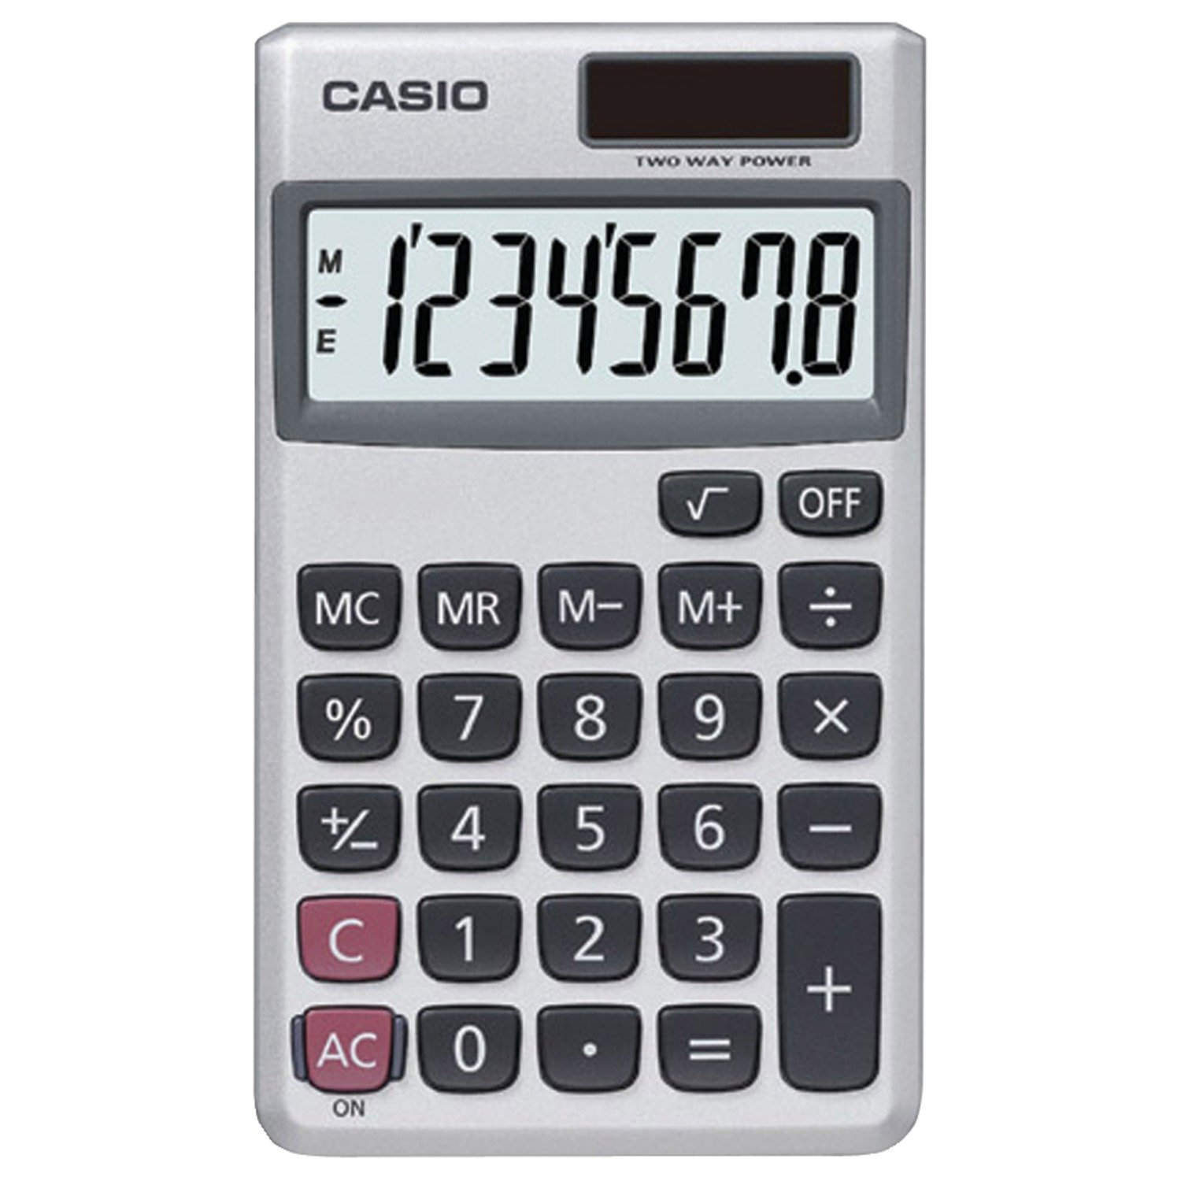
Think of a Calculator
How will you write a program for a calculator?
3 major steps:
Take user input and store in memory
Perform calculations
Display the result

Slide 5
Variables
Variables are like boxes in which you can store values
When you write
int myBox;
you get a variable named “myBox” in which you can store an integer.
Such a statement is called the declaration of variable myBox
Declaration tells the compiler about the name of the variable and the type of values you will store in the variable.
myBox

Slide 6
Variables
Once you have declared a variable, you can use it freely to store values of the particular type
myBox = 22;
Further you can combine these two statements too.
int myBox = 22;
“Give me a box which can store integers and put 22 into it.”
22
myBox

Slide 7
Variables
The value of variables can be changed during your program
You can print the variables using cout
int score = 11;
score = 11 + 1;
11
score
12
int roll = 11;
cout << roll;
Output :
11

Slide 8
Variables
Value stored in variables can be copied
Formal definition : Variables are named storage locations whose value can be changed in the program.
Tip : Always remember to declare a variable before using it, otherwise compiler would give an error.
int score = 11;
int temp;
temp = score;
11
score
temp
11

Slide 9
Variables in action
#include <iostream.h>
int main()
{
int myMarks = 97;
cout << "My marks are " << myMarks;
return 0;
}
Output :
My marks are 97

Slide 10
Exercise
#include <iostream.h>
int main()
{
int myMarks = 97/10;
cout << "My marks are " << myMarks;
return 0;
}

Slide 11
Exercise
#include <iostream.h>
int main()
{
int myMarks = 97/10;
cout << "My marks are " << myMarks;
return 0;
}
Output :
My marks are 9

Slide 12
Reading input using cin
The cin statement is used to read input from the keyboard into variables.
When you write
int num;
cin >> num;
you are reading an integer from the keyboard into the variable num.

Slide 13
cin in action
The following program reads an integer from the input and prints it :
#include <iostream.h>
int main()
{
int number;
cout << "Enter a number : ";
cin >> number;
cout << "The number entered is : ";
cout << number;
return 0;
}
This 23 is the input
Output :
Enter a number : 23
The number entered is : 23

Slide 14
Exercise
Write a program which takes a positive integer as input from user and prints its last 3 digits.
For example,
Input : 1224 Output : 224
Input : 34 Output : 34

Slide 15
What’s ahead?
In the next video, we will study see more examples of variables input and output

